Slide 1



Course Name software Development project management
CSC 4125
(Undergraduate)
Chapter 7 activity planning
Software engineering (Undergraduate)
M. Mahmudul hasan
Assistant Professor, CS, AIUB
http://www.dit.hua.gr/~m.hasan

Slide 2
Objective of Activity planning
MMH
Feasibility Assessment: is the project possible (realistically) and within required timescales and resource constraints?
Resource Allocation: allocating resources in the project in most effective ways (e.g. when should they be need and available)
Detailed Costing: how much will the project cost and when is that expenditure likely to take place?
Motivation: providing targets and being able to see the achievement against targets is an effective way of motivating staff.
Co-ordination: in large projects there are more than a single team involving in the project where activity planning provides an effective vehicle for communication and co-ordination among various teams (e.g. when do the staff in different departments need to be available work in a particular project)

Slide 3
Projects & activities
MMH
Defining Activities
A project is composed of a number of interrelated activities
A project may start when at least one of its activities is ready to start
A project will be completed when all of the activities it encompasses have been completed
An activity must have a clearly defined start and a clearly defined end-point, normally marked by the production of a tangible deliverable
If an activity requires a resource (as most do) then that resource requirement must be forecastable and is assumed to be required at a constant level throughout the duration of the activity
The duration of an activity must be forecastable – assuming normal circumstances and the reasonable availability of resources
Some activities may require that others are completed before they can begin (these are known as precedence requirements)

Slide 4
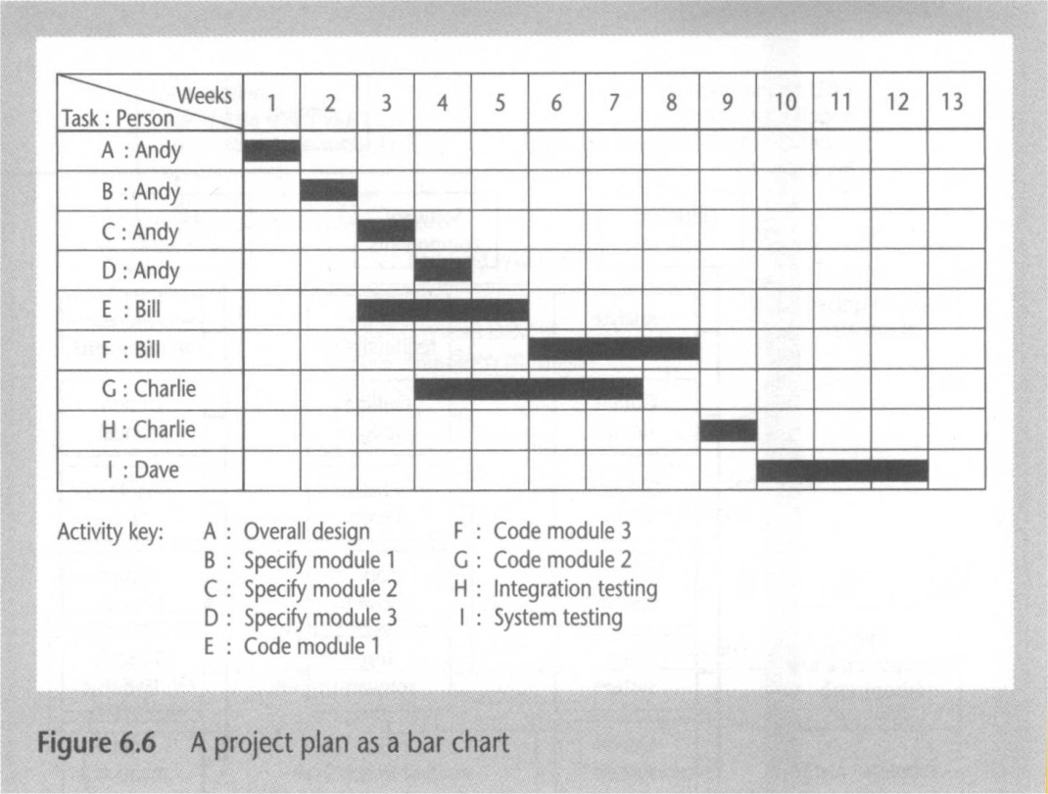
Sequencing and scheduling activities
MMH

Slide 5
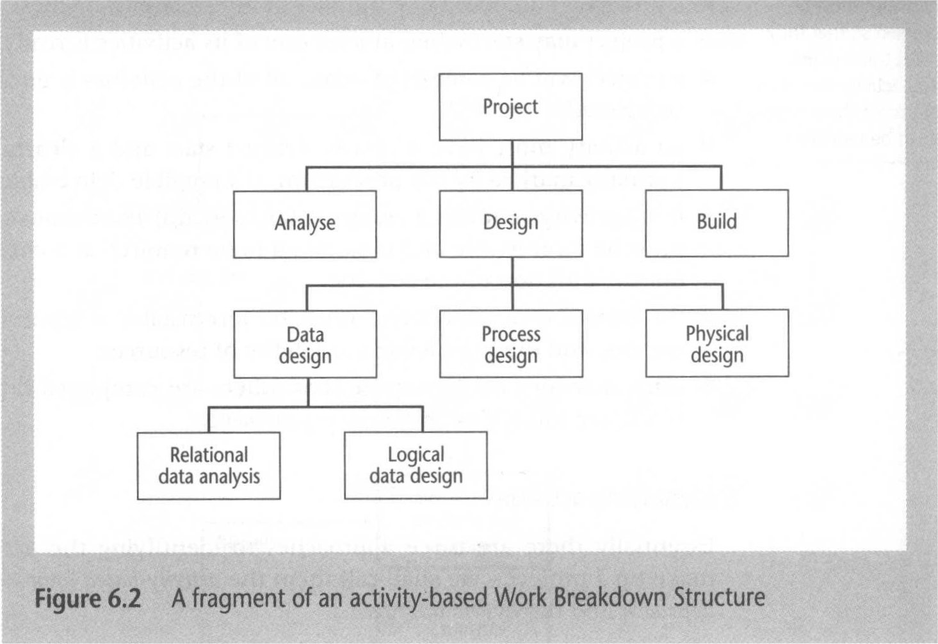
Identifying activities: Activity-based approach
Slide-5
MMH
Create a list of all the activities in a project (process verification)
- Relational database (table) - Conceptual Modeling

Slide 6
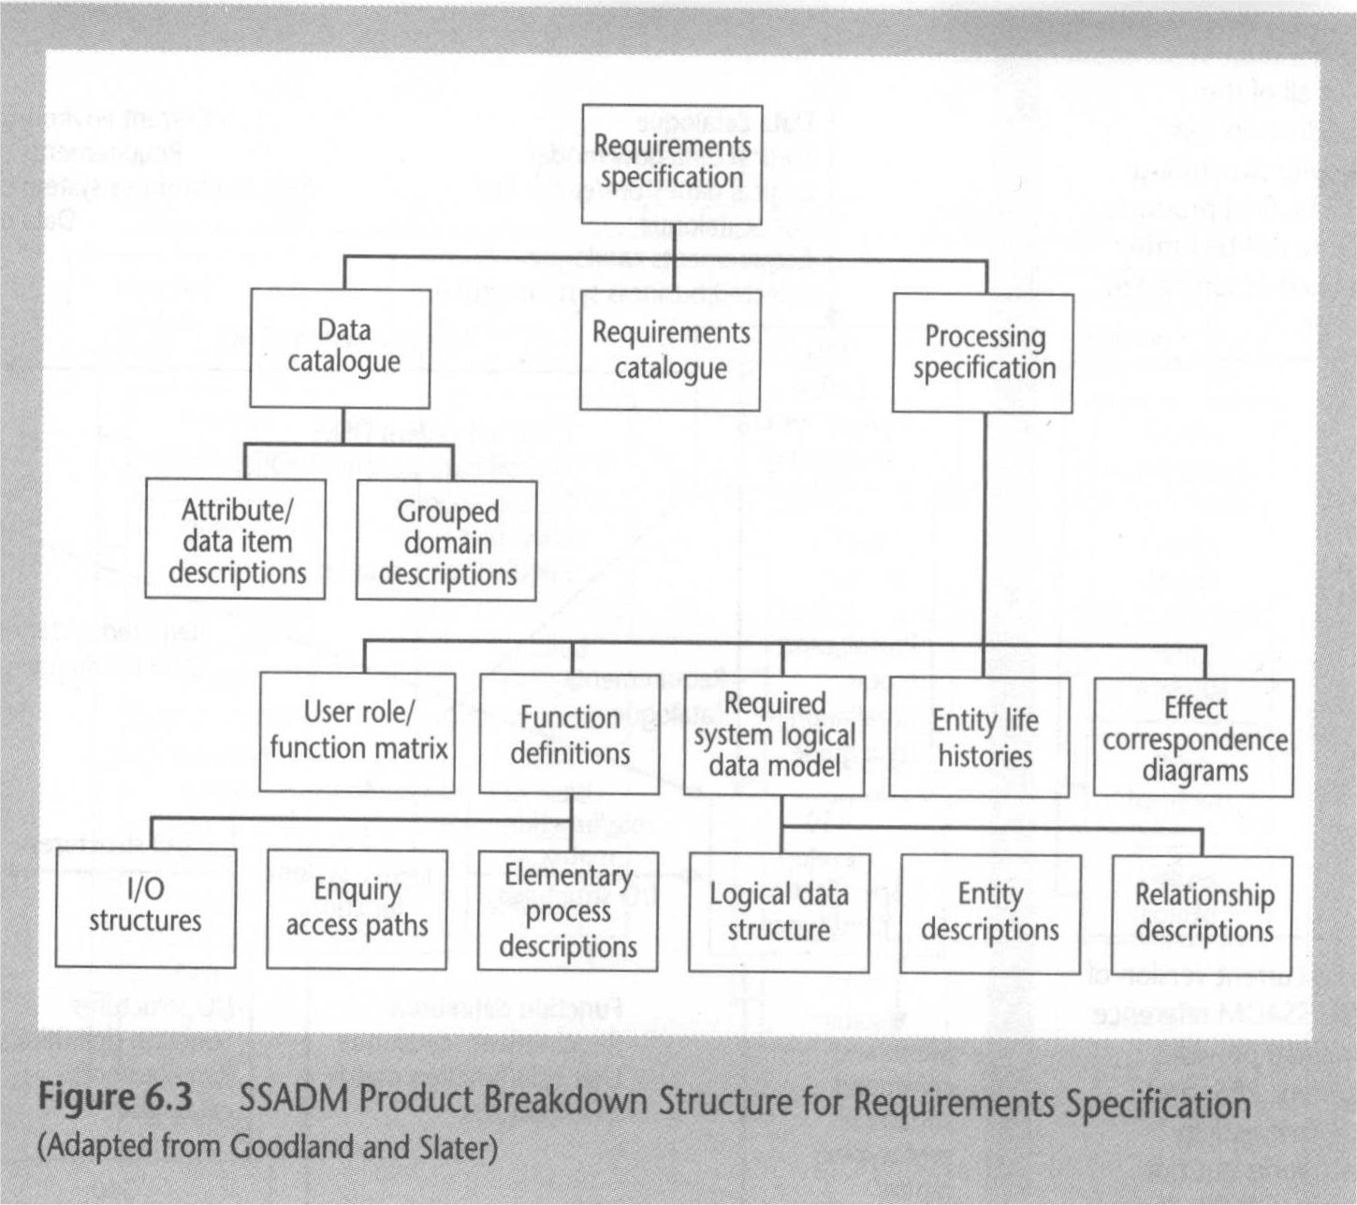
Identifying activities: Product-based approach
Slide-6
MMH
Produce product breakdown structure and product flow diagram (validation)

Slide 7
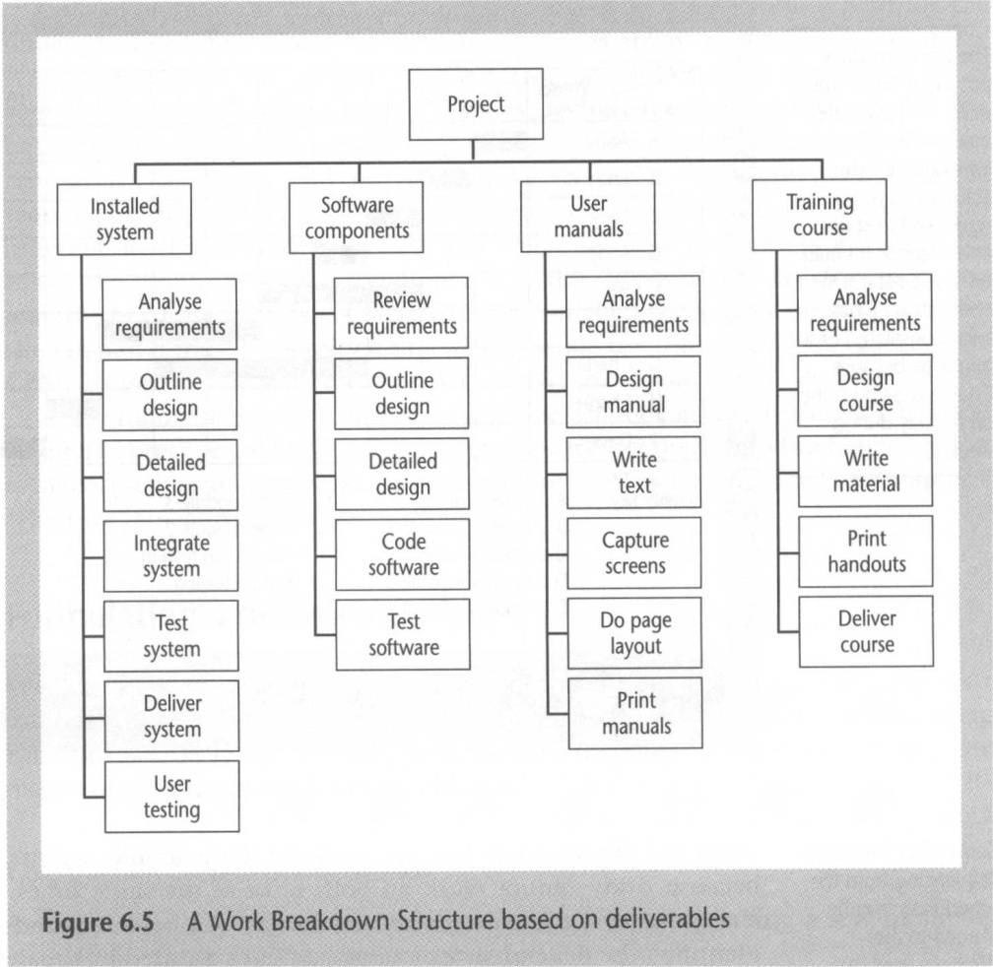
Identifying activities: hybrid approach
Slide-7
MMH
Work breakdown structure based on final deliverables and for each deliverable, a set of activities required to produce that product.

Slide 8
Network planning model
MMH
This project scheduling techniques model the project’s activities and their relationships as a network
Precedence Networks (Activity-On-Node)
CPM – Critical Path Method (Activity-On-Arrow)
PERT – Program Evaluation Review Technique

Slide 9
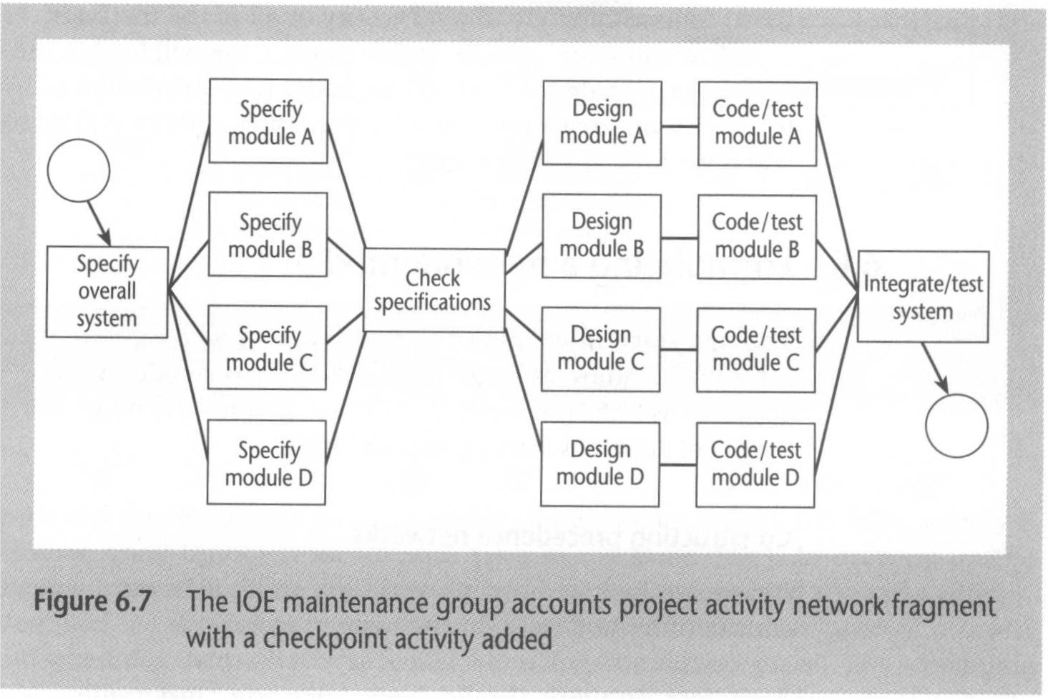
Ioe activity Network fragment
MMH

Slide 10
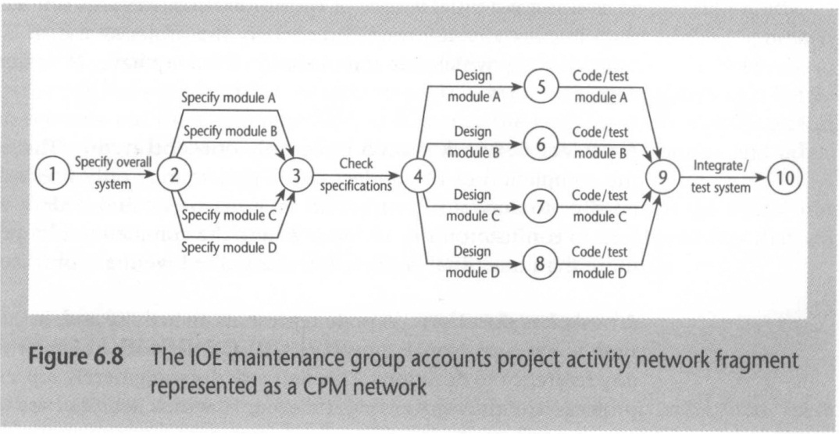
Ioe activity CMP Network fragment
MMH

Slide 11
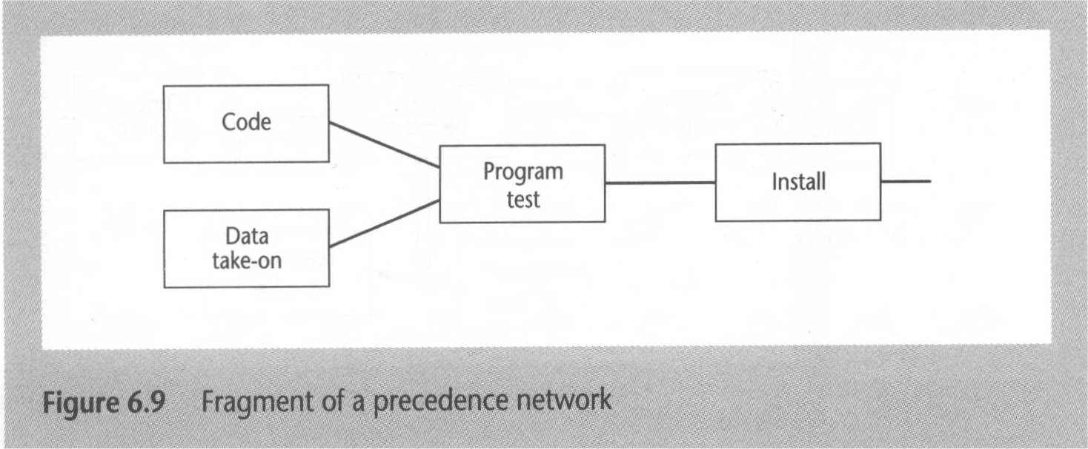
Formulating a Network model - PERT
Slide-11
MMH
Constructing Precedence (priority) Networks - the activity INSTALL cannot start until TEST has been completed (fig-6.9)
Precedents are the immediate preceding activities – CODE & DATA-TAKE-ON are not taken in into consideration as the precedents of INSTALL

Slide 12
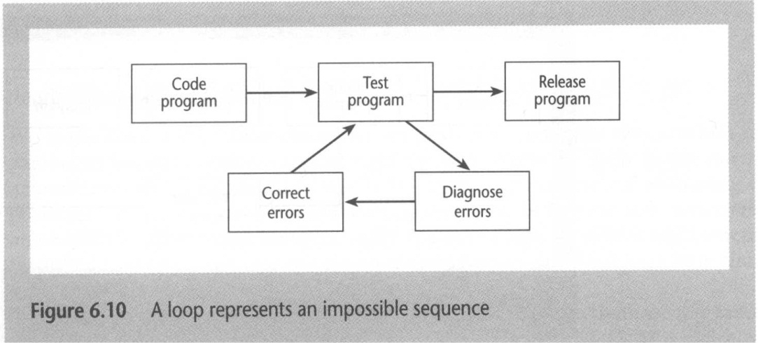
Formulating a Network model
Slide-12
MMH
A project network should only have one start node - it does not have to wait for any other activities to be completed.
A project network should only have one end node - project may only finish once
Links have duration – a link represents an activity
Nodes have no duration – nodes are events as such instantaneous points of time.
Time moves from left to right – usually indication of an arrow is left-to-right
A network should not contain loops – a loop is an error in that it represents a situation that cannot occur in practice

Slide 13
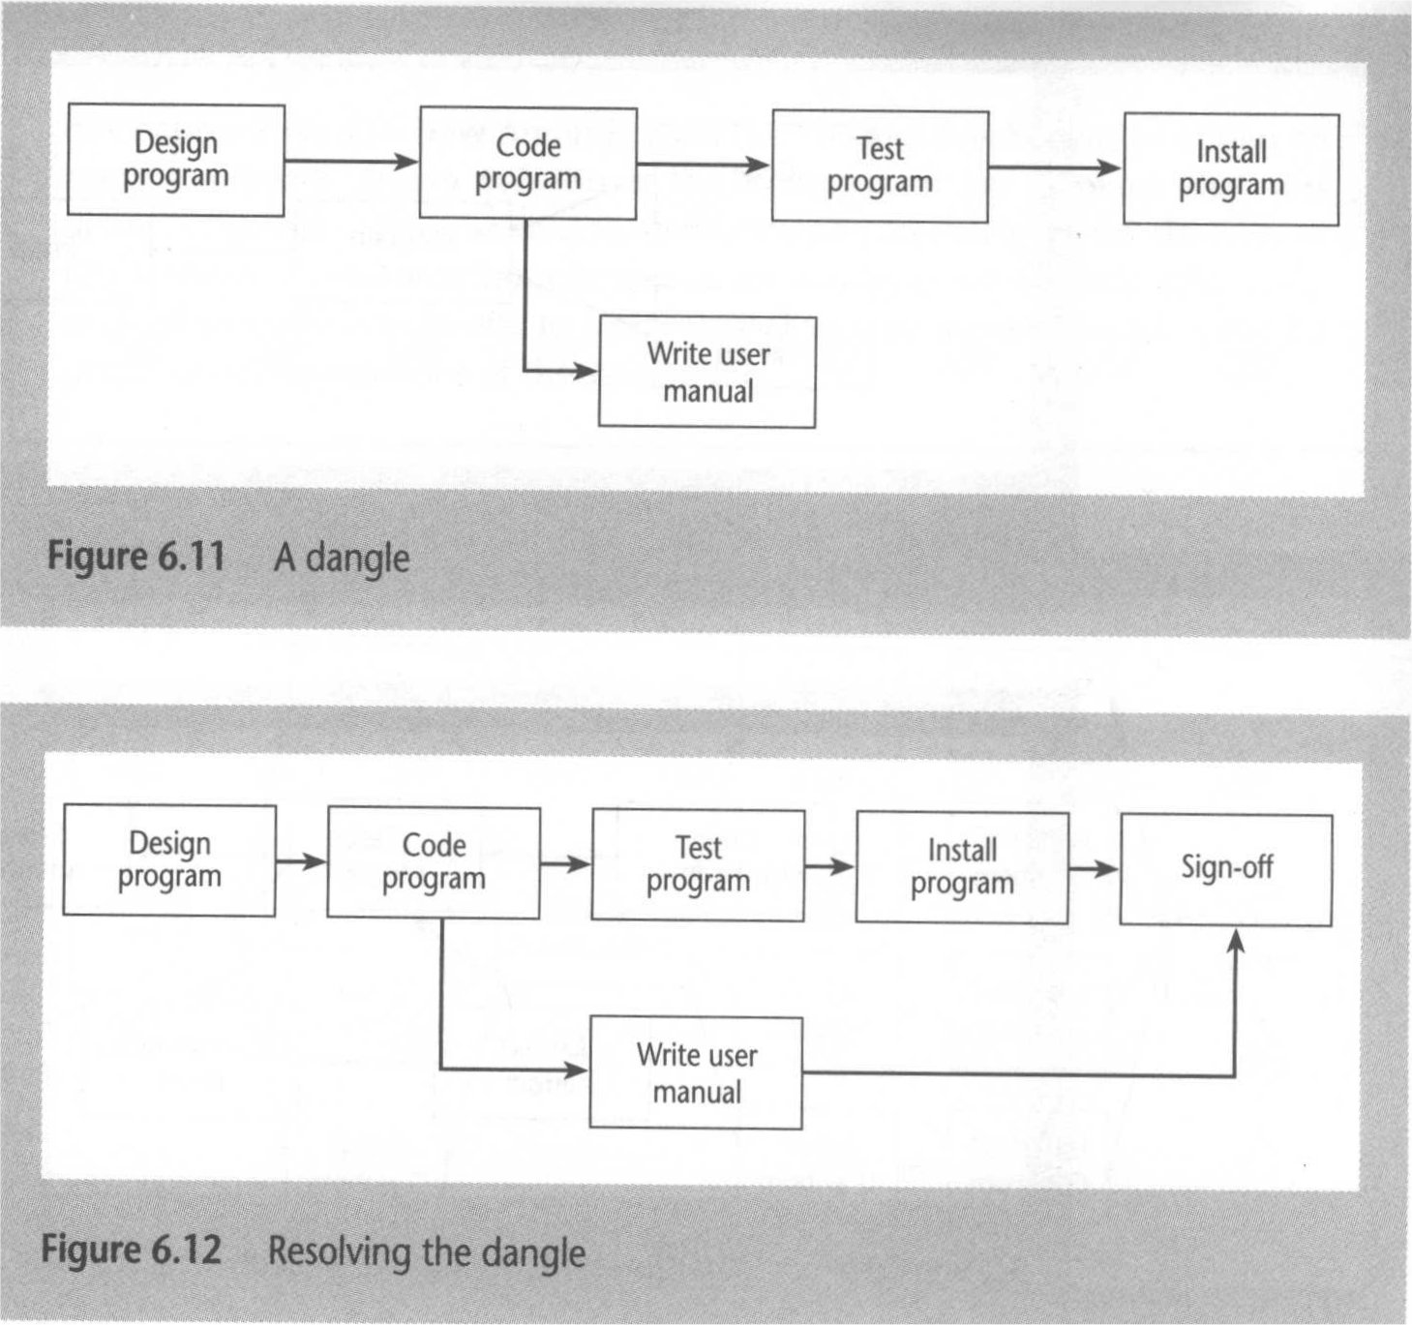
Formulating a Network model
Slide-13
MMH
A network should not contain dangles – loosely coupled node suggests two project completion points

Slide 14
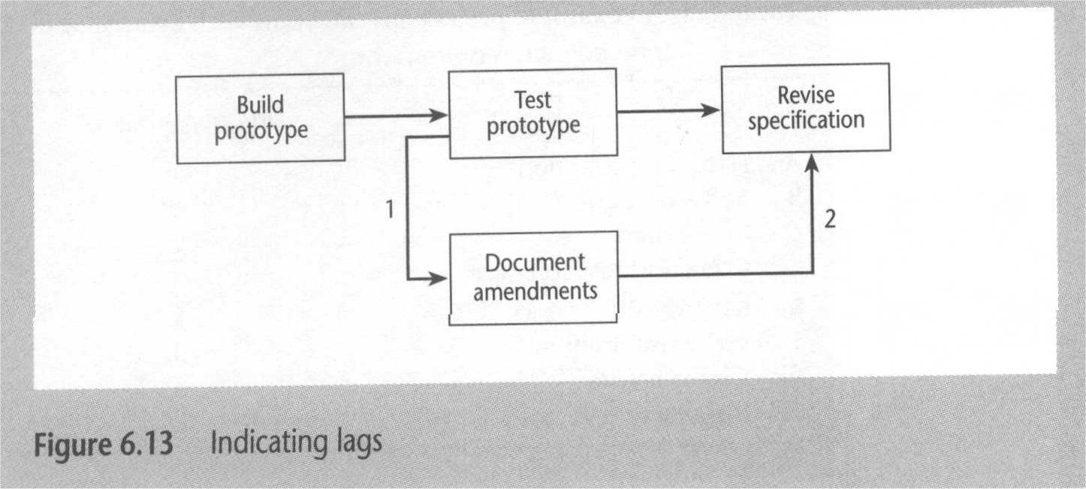
Formulating a Network model
MMH
Representing lagged activities – in case of undertake two activities in parallel, where the activities are lagged because a stage in one activity must be completed before the other may proceed.

Slide 15
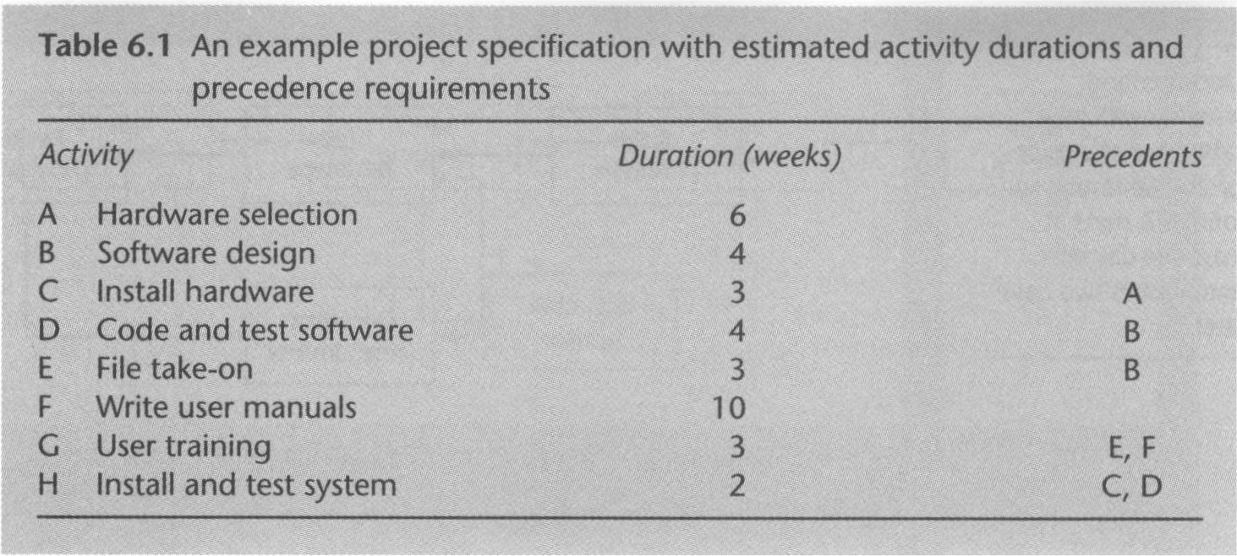
Project activity example
MMH

Slide 16
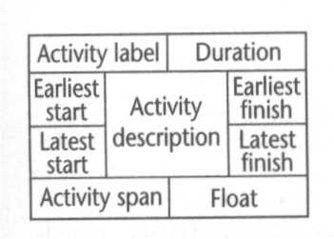
Formulating a Network model
MMH
Labeling conventions

Slide 17
Formulating a Network model 1
MMH
Duration = table 6.1
A |  | 6 Weeks
 | Hardware Selection
C |  | 3 Weeks
 | Install Hardware
B |  | 4 Weeks
 | Software Design
D |  | 4 Weeks
 | Code and Test Software
H |  | 2 Weeks
 | Install and test System
Start
Finish
E |  | 3 Weeks
 | File take-on
F |  | 10 Weeks
 | User Manual
G |  | 3 Weeks
 | User Training

Slide 18
Formulating a Network model 1
MMH
Earliest start = earliest start (previous node) + duration (previous node)
A |  | 6 Weeks
0 | Hardware Design
C |  | 3 Weeks
6 | Install Hardware
B |  | 4 Weeks
0 | Software Design
D |  | 4 Weeks
4 | Code and Test Software
H |  | 2 Weeks
9 | Install and test System
Start
Finish
E |  | 3 Weeks
4 | File take-on
F |  | 10 Weeks
0 | User Manual
G |  | 3 Weeks
10 | User Training
0+10

Slide 19
Formulating a Network model 2
MMH
Longest duration (i.e. 13weeks, F10+G3 = 13)
Latest finish = latest finish (successor node) - duration (successor node)
A |  | 6 Weeks
0 | Hardware Design
 |  |  | 8
C |  | 3 Weeks
6 | Install Hardware
 |  |  | 11
11-3
13-2
B |  | 4 Weeks
0 | Software Design
 |  |  | 7
D |  | 4 Weeks
4 | Code and Test Software
 |  |  | 11
H |  | 2 Weeks
9 | Install and test System
 |  |  | 13
Start
Finish
11-4
13-2
10-3
E |  | 3 Weeks
4 | File take-on
 |  |  | 10
F |  | 10 Weeks
0 | User Manual
 |  |  | 10
G |  | 3 Weeks
10 | User Training
 |  |  | 13
13-3

Slide 20
Formulating a Network model 3
MMH
Earliest finish = earliest start (individual node) + duration (individual node)
A |  | 6 Weeks
0 | Hardware Design |  | 6
 |  |  | 8
C |  | 3 Weeks
6 | Install Hardware |  | 9
 |  |  | 11
B |  | 4 Weeks
0 | Software Design |  | 4
 |  |  | 7
D |  | 4 Weeks
4 | Code and Test Software |  | 8
 |  |  | 11
H |  | 2 Weeks
9 | Install and test System |  | 11
 |  |  | 13
Start
Finish
E |  | 3 Weeks
4 | File take-on |  | 7
 |  |  | 10
F |  | 10 Weeks
0 | User Manual |  | 10
 |  |  | 10
G |  | 3 Weeks
10 | User Training |  | 13
 |  |  | 13

Slide 21
Formulating a Network model 4
MMH
Latest start = latest finish (individual node) - duration (individual node)
A |  | 6 Weeks
0 | Hardware Design |  | 6
2 |  |  | 8
C |  | 3 Weeks
6 | Install Hardware |  | 9
8 |  |  | 11
B |  | 4 Weeks
0 | Software Design |  | 4
3 |  |  | 7
D |  | 4 Weeks
4 | Code and Test Software |  | 8
7 |  |  | 11
H |  | 2 Weeks
9 | Install and test System |  | 11
11 |  |  | 13
Start
Finish
E |  | 3 Weeks
4 | File take-on |  | 7
7 |  |  | 10
F |  | 10 Weeks
0 | User Manual |  | 10
0 |  |  | 10
G |  | 3 Weeks
10 | User Training |  | 13
10 |  |  | 13

Slide 22
Formulating a Network model 5
MMH
Float = earliest start/finish (individual node) – latest start/finish (individual node)
A |  | 6 Weeks
0 | Hardware Design |  | 6
2 |  |  | 8
 |  | 2
C |  | 3 Weeks
6 | Install Hardware |  | 9
8 |  |  | 11
 |  | 2
B |  | 4 Weeks
0 | Software Design |  | 4
3 |  |  | 7
 |  | 3
D |  | 4 Weeks
4 | Code and Test Software |  | 8
7 |  |  | 11
 |  | 3
H |  | 2 Weeks
9 | Install and test System |  | 11
11 |  |  | 13
 |  | 2
Start
Finish
E |  | 3 Weeks
4 | File take-on |  | 7
7 |  |  | 10
 |  | 3
F |  | 10 Weeks
0 | User Manual |  | 10
0 |  |  | 10
 |  | 0
G |  | 3 Weeks
10 | User Training |  | 13
10 |  |  | 13
 |  | 0

Slide 23
Formulating a Network model 6
MMH
Activity span = duration (individual node) + float (individual node)
A |  | 6 Weeks
0 | Hardware Design |  | 6
2 |  |  | 8
8 |  | 2
C |  | 3 Weeks
6 | Install Hardware |  | 9
8 |  |  | 11
5 |  | 2
B |  | 4 Weeks
0 | Software Design |  | 4
3 |  |  | 7
7 |  | 3
D |  | 4 Weeks
4 | Code and Test Software |  | 8
7 |  |  | 11
7 |  | 3
H |  | 2 Weeks
9 | Install and test System |  | 11
11 |  |  | 13
4 |  | 2
Start
Finish
E |  | 3 Weeks
4 | File take-on |  | 7
7 |  |  | 10
6 |  | 3
F |  | 10 Weeks
0 | User Manual |  | 10
0 |  |  | 10
10 |  | 0
G |  | 3 Weeks
10 | User Training |  | 13
10 |  |  | 13
3 |  | 0

Slide 24
Formulating a Network model 7
MMH
Critical Path – float 0
A |  | 6 Weeks
0 | Hardware Design |  | 6
2 |  |  | 8
8 |  | 2
C |  | 3 Weeks
6 | Install Hardware |  | 9
8 |  |  | 11
5 |  | 2
B |  | 4 Weeks
0 | Software Design |  | 4
3 |  |  | 7
7 |  | 3
D |  | 4 Weeks
4 | Code and Test Software |  | 8
7 |  |  | 11
7 |  | 3
H |  | 2 Weeks
9 | Install and test System |  | 11
11 |  |  | 13
4 |  | 2
Start
Finish
Critical Path
E |  | 3 Weeks
4 | File take-on |  | 7
7 |  |  | 10
6 |  | 3
F |  | 10 Weeks
0 | User Manual |  | 10
0 |  |  | 10
10 |  | 0
G |  | 3 Weeks
10 | User Training |  | 13
10 |  |  | 13
3 |  | 0
Critical Path
Critical Path

Slide 25
Refining the Network model
MMH
Adding the time dimension – for each activity an estimate of its duration
The forward pass – calculate the earliest date on which each activity may be started and completed
The backward pass – calculate latest date at which each activities started and finished without delaying the end date of the project
Identifying the critical path – Difference between the earliest date and latest date for an event is know as slack (it is a measure of how late an event may be without affecting the end date of the project). – Any event with a slack of zero is critical in the sense that any delay in achieving that event will delay the completion date of the project as a whole. – There will always be at least one path through the network joining those critical events – this path is know as the critical path (Fig. 6.20).

Slide 26
Refining the Network model
MMH
Activity Float
Total Float – whereas events have slack, activities posses float. The total float is the difference between the earliest start date of an activity and its latest start (or difference between its earliest finish and its latest finish)
Free Float – the time by which an activity may be delayed without affecting any subsequent activity. It is calculated as the difference between the earliest completion date for the activity and the earliest start date of the succeeding activity (e.g. in case of multiple precedence activities)
Interfering Float – the difference between total float and free float. Once the free float has been used, the interfering float tells us by how much the activity may be delayed without delaying the project end date even though it will delay the start of subsequent activities.

Slide 27
references
MMH
Bob Hughes and Mike Cotterel (1999). Software Project Management (Second Edition).
PMBOK Guide: Project Lifecycle (5th Edition)

